Slide 1
Organization of Finance Function
Organization of finance function means the division of functions relating to finance and to set up a sound and efficient organization for performing the finance functions. Since the financial decisions are very crucial for the survival as well as growth and development of the firm, the ultimate responsibility of carrying out the finance function lies with the top management. Hence, a department to organize and carry out the financial activities is created under the direct control of the board of directors. This department is headed by a financial manager. Major financial policy matters will be decided by the financial manager whereas the routine financial matters will be delegated to lower levels.

Slide 2
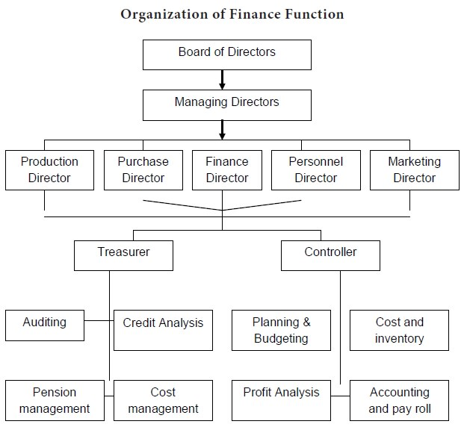

Slide 3
THANK
YOU

